Slide 1

David M. Kroenke and David J. Auer Database Processing: Fundamentals, Design, and Implementation
Chapter One:
Introduction

Slide 2
The Characteristics of Databases
The purpose of a database is to help people track things of interest to them.
Data is stored in tables, which have rows and columns like a spreadsheet. A database may have multiple tables, where each table stores data about a different thing.
Each row in a table stores data about an occurrence or instance of the thing of interest.
A database stores data and relationships.

Slide 3
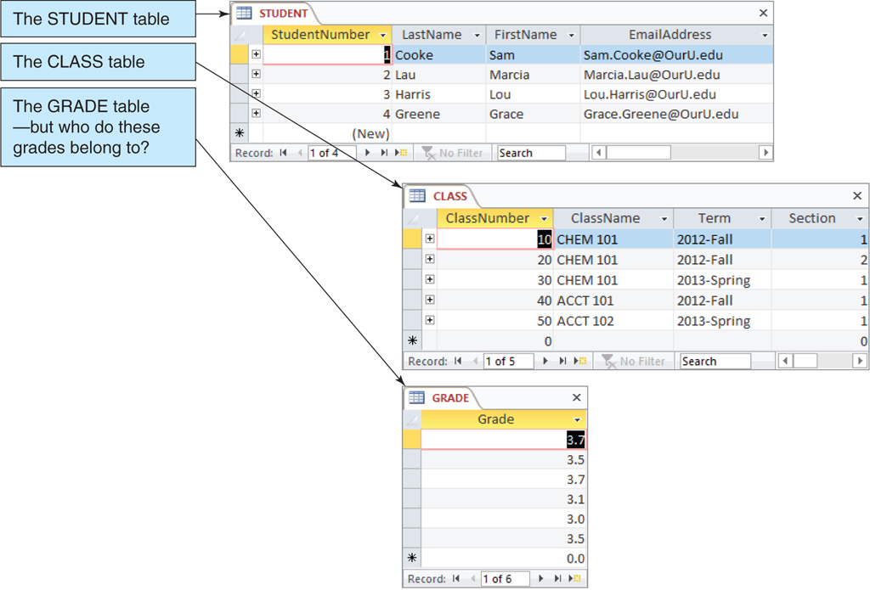
Data in Tables

Slide 4
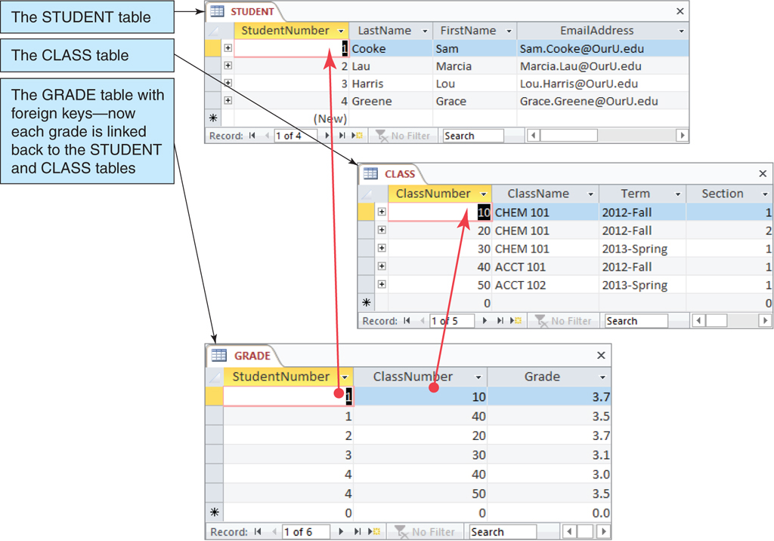
The Key Characteristic of Databases: Related Tables

Slide 5
Naming Conventions in this Textbook
Table names are written with all capital letters:
STUDENT, CLASS, GRADE
Column names are written with an initial capital letter, and compound names are written with a capital letter on each word:
Term, Section, ClassNumber, StudentName

Slide 6
Databases Create Information
Data = recorded facts and figures
Information = knowledge derived from data
Databases record data, but they do so in such a way that we can produce information from the data.
The data on STUDENTs, CLASSes, and GRADEs could produce information about each student’s GPA.

Slide 7
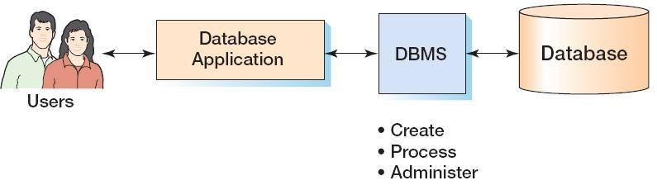
Components of a Database System

Slide 8
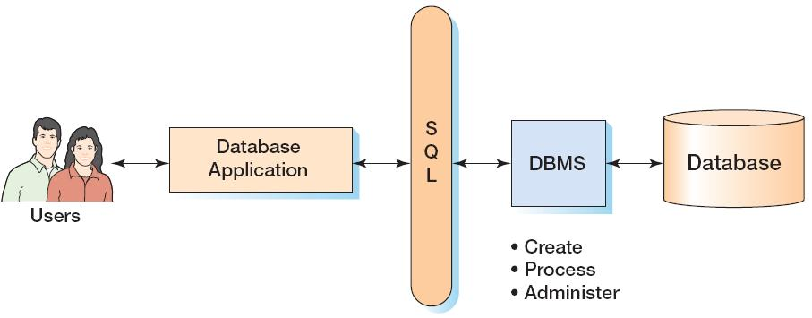
Components of a Database System with SQL

Slide 9
Applications, the DBMS, and SQL
Applications are the computer programs that users work with.
The Database Management System (DBMS) creates, processes, and administers databases.
Structured Query Language (SQL) is an internationally recognized standard database language that is used by all commercial DBMSs.

Slide 10
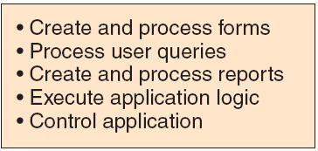
Database Applications

Slide 11
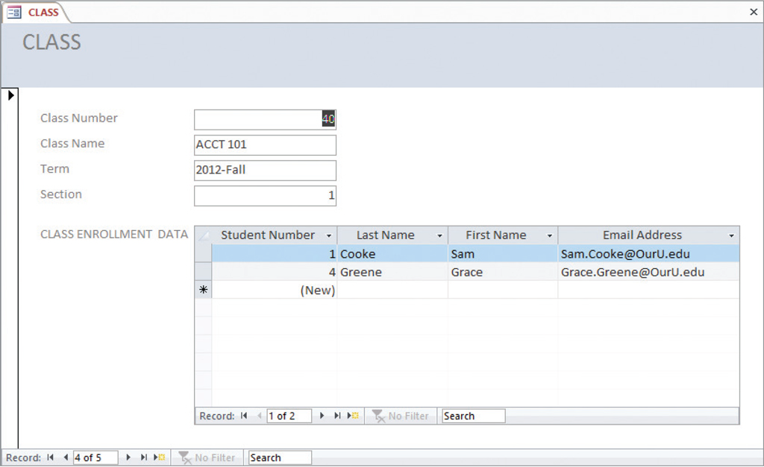
Database Applications—Forms

Slide 12
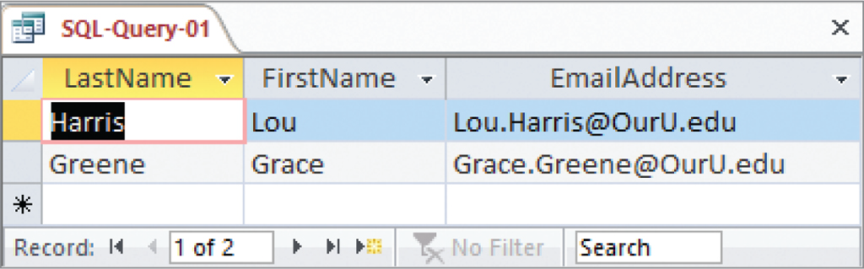
Database Applications—Queries
SELECT LastName, FirstName, EmailAddress
FROM STUDENT
WHERE StudentNumber > 2;

Slide 13
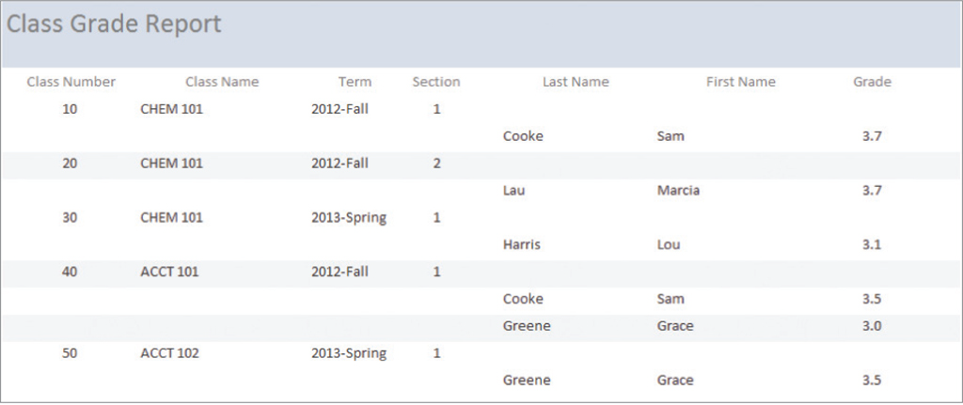
Database—Reports

Slide 14
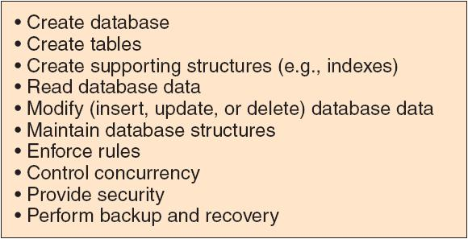
The DBMS

Slide 15
The Database
A database is a self-describing collection of integrated tables.
The tables are called integrated because they store data about the relationships between the rows of data.
A database is called self-describing because it stores a description of itself.
The self-describing data is called metadata, which is data about data.

Slide 16
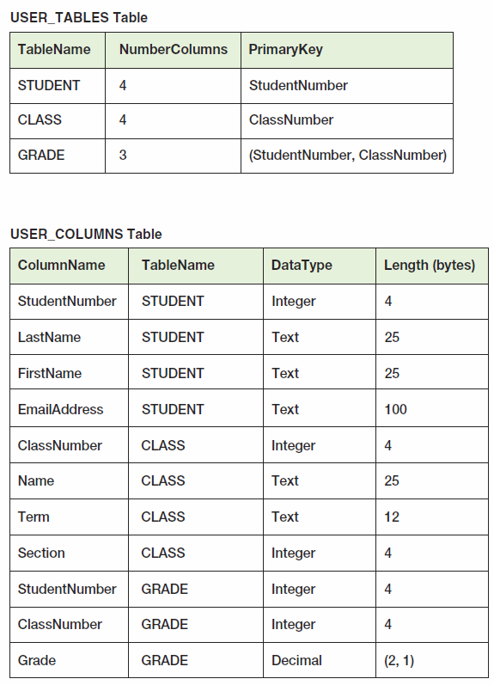
Typical Metadata Tables

Slide 17
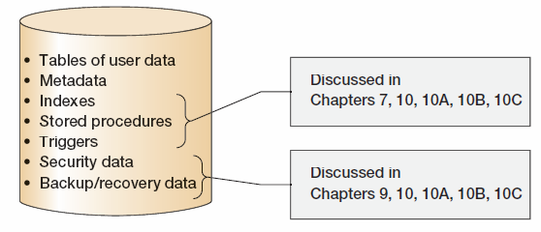
Database Contents

Slide 18
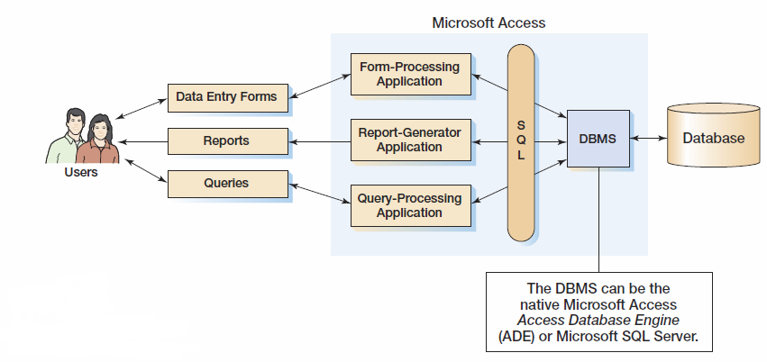
Personal Database Systems: Microsoft Access

Slide 19
Microsoft Access
Microsoft Access is a low-end product intended for individual users and small workgroups.
Microsoft Access tries to hide much of the underlying database technology from the user.
A good strategy for beginners, but not for database professionals.
NOTE: Microsoft Access 2013 is discussed in detail in Appendix A.

Slide 20
What Is Microsoft Access?
Microsoft Access is a DBMS plus an application generator:
The DBMS creates, processes, and administers Microsoft Access databases.
The application generator includes query, form, and report components.
The Microsoft Access DBMS engine is called the Access Data Engine (ADE).
Microsoft Access 2000 thru 2010 can be used as an application generator for the Microsoft SQL Server DBMS.

Slide 21
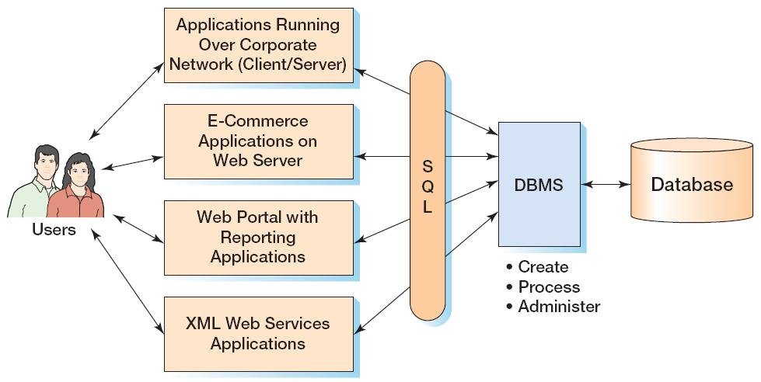
Enterprise-Class Database Systems

Slide 22
Prominent DBMS Products
Microsoft Access 2013
Microsoft SQL Server 2012
Microsoft SQL Server 2012 Express
Oracle Corporation Oracle Database 11g Release 2
MySQL 5.6
IBM DB2

Slide 23
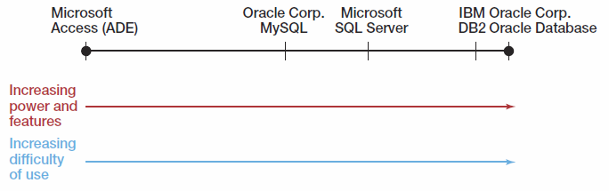
DBMS Power vs. Ease of Use

Slide 24
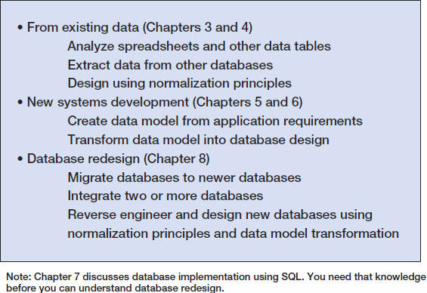
Three Types of Database Design

Slide 25
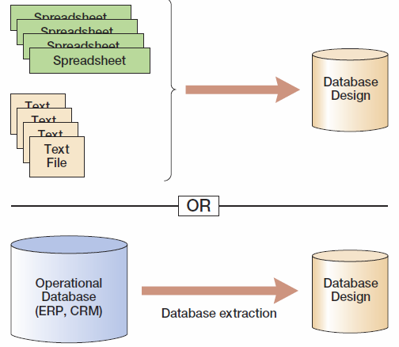
Database Design from Existing Data

Slide 26
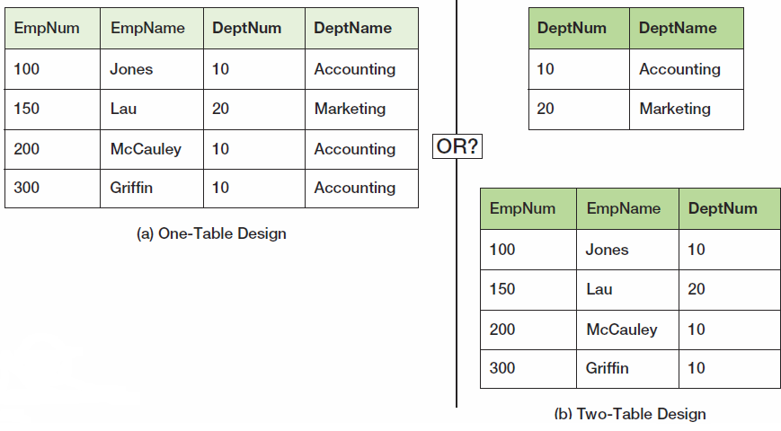
Data Import: One or Two Tables?
This is an important decision, and based on a set of rules known as normalization (which is covered in Chapter 3).

Slide 27
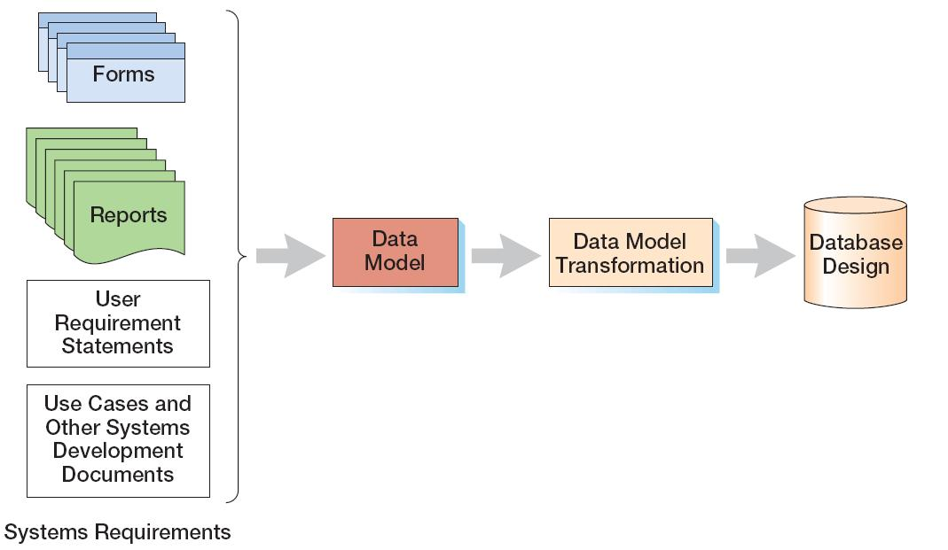
Database Design from New Systems Development
Entity-Relationship data modeling is covered in Chapter 5, and data model transformations to database designs are covered in Chapter 6.

Slide 28
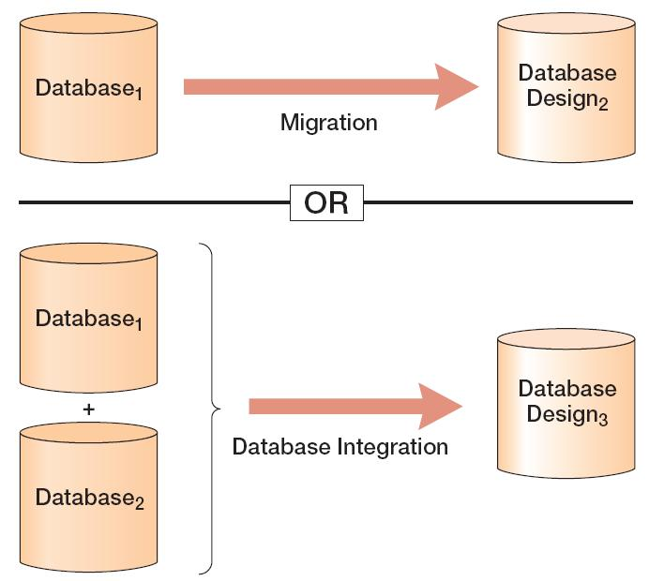
Database Design from Database Redesign
Database redesign is covered in Chapter 8, after coverage of SQL in Chapter 7.

Slide 29
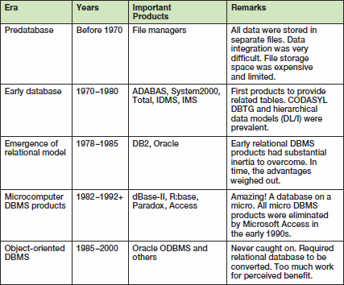
A Brief History of Database Processing I

Slide 30
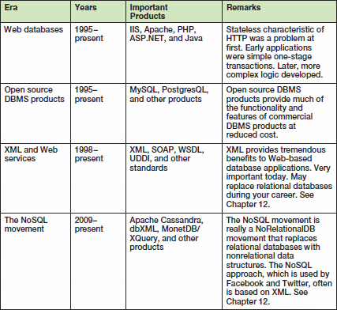
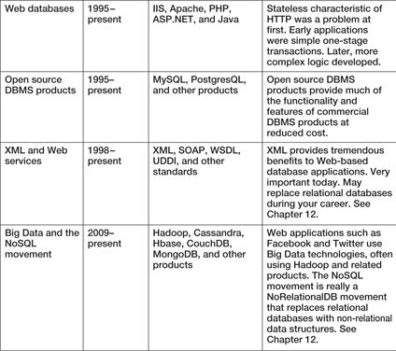
A Brief History of Database Processing II

Slide 31
The Relational Database Model
The dominant database model is the relational database model—all current major DBMS products are based on it.
It was created by IBM engineer E. F. Codd in 1970.
It was based on mathematics called relational algebra.
This text examines and explains the relational database model.

